Slide 1
ISSS2015 Berlin, Germany : August 2-7, 2015 PoSITeams Positive Systems Intelligent Teams an Agent-Based Simulator for Studying Group Behaviour
Teemu Tiinanen, Juha Törmänen, Raimo P. Hämäläinen, and Esa Saarinen
Systems Analysis Laboratory, Aalto University, Finland

Slide 2
Background
Operations Research
Systems Thinking in organization
- Organizational learning
- Peter Senge: The Fifth Discipline (1990)
Systems Intelligence, Raimo P. Hämäläinen and Esa Saarinen (2004)
Positive psychology, Barbara Fredrickson (1998)
Affective computing, Rosalind Picard (1997)

Slide 3
Agent-Based Modelling
Agent Based Modelling (ABM) is an actively growing ﬁeld
Applications, e.g.:
Information diﬀusion in social networks
Emergence of social phenomena
Crowd behaviour (disasters, evacuations)
Analysis of markets

Slide 4
Agent-Based Modelling
Operations Research - the Science of Better - can also beneﬁt from the agent approach in improving the performance of social systems
We have developed PoSITeams, a web-based organizational social simulator with a focus on the effects of positivity

Slide 5
Simulating the effects of emotions in teams
Simulating positive and negative affect
Helps study how they influence people and groups
Illustrates behavioural effects
Supports personal and organizational decision making:
How can I best adjust my behaviour to have a positive impact on my group?
Bridging Positivity Research and Operations Research
Analysis and “optimization” of social behaviour in groups and organizations

Slide 6
Positivity
Broaden-and-build theory (Barbara Fredrickson, 1998): positive emotions
broaden awareness
build cognitive, social, psychological, emotional and physical resources
increase the ability to cope with negativity
can become a positive feedback loop towards emotional well-being

Slide 7
Positivity ratio (P/N)
High ratio of positive to negative affect (P/N):
inﬂuences behaviour
people with high P/N “ﬂourish”, Fredrickson (2004)
increases the performance of social groups:
eﬀective organizations, Losada (2004)
successful marriages, Gottman (2002)
increases the number of strong connections in the team, Losada (2004)

Slide 8
Systems Intelligence
Ability to act intelligently within complex systems involving interaction and feedback
Introduced in 2004 by Raimo P. Hämäläinen and Esa Saarinen in Aalto University
Our focus:
The structure of the system and the agents’ ability to act intelligently in the system
Seeing and using leverage points

Slide 9
The eight dimensions of SI

Slide 10
Systems Intelligence
http://systemsintelligence.aalto.fi

Slide 11
Emotional Contagion Model
$P_{j}(t)$, $N_{j}(t)$: state variables of positivity and negativity of the agent j
Decay over time: old inputs become less significant
The ratio $P_{j}(t)/N_{j}(t)$ defines agent’s interaction style
“Broaden”: high P/N increases connection strengths
“Build”: high P/N decreases the effects of negativity

Slide 12
Emotional Contagion Model
$$P_{j}\left(t+1\right)=a_{j}P_{j}\left(t\right)+b_{j}+(1−β_{j})\sum_{i≠j}{γ_{i,j}P_{i}^{rel}\left(t\right)}$$
$$N_{j}\left(t+1\right)=c_{j}N_{j}\left(t\right)+d_{j}+β_{j}\sum_{i≠j}{γ_{i,j}N_{i}^{rel}\left(t\right)}$$
P, N positivity and negativity of the agent
$β_{j}$ negativity/positivity bias
$γ_{i,j}=ε_{i}α_{i,j}δ_{j}$ emotional contagion strength between agents i and j, where
$ε_{i}$ how strongly agent i expresses its level of emotion
$α_{i,j}$ social connection strength between agents i and j
$δ_{j}$ how easily the emotions of agent j are aﬀected by the emotions of others
$P_{i}^{rel}=1−N_{i}^{rel}=P_{i}/(P_{i}+N_{i})$ relative positivity/negativity

Slide 13
Broaden-and-build extension
High P/N increases resilience towards negative events:
$β_{j}\left(t\right)=P_{j}^{rel}\left(t−1\right)\left(β_{j}^{MIN}−β_{j}^{MAX}\right)−β_{j}^{MIN}+1$
High P/N also increases connectivity, sociability and the feeling of “oneness”:
$δ_{j}\left(t\right)=P_{j}^{rel}\left(t−1\right)\left(δ_{j}^{MAX}−δ_{j}^{MIN}\right)+δ_{j}^{MIN}$
$ε_{j}\left(t\right)=P_{j}^{rel}\left(t−1\right)\left(ε_{j}^{MAX}−ε_{j}^{MIN}\right)+ε_{j}^{MIN}$

Slide 14
Interactive use of PoSITeams
Agents and their connections can be added, removed and modiﬁed
The characteristics of an agent is adjusted by:
General positivity, P/N in the uninﬂuenced steady state
Extroversion $ε_{i}$
Emotional sensitivity $δ_{j}$
Negativity bias $β_{j}$
Social connection strengths $α_{i,j}$

Slide 15
Improving team behaviour
Simulator can suggest systems intelligent actions
Optimization of agent and team parameters
solution by simulated annealing
The user can add constraints to model parameters
Costs can be assigned to making a change in the behavioural parameters
Reﬂects the human mental eﬀort of change

Slide 17
Using PoSITeams

Slide 18
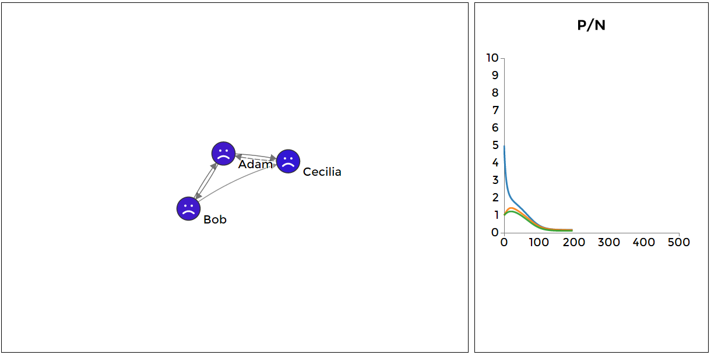
Improve agent’s personal behaviour
Initial configuration at its steady state

Slide 19
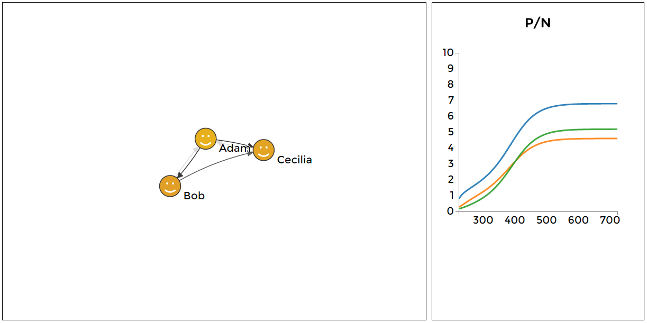
Improve agent’s personal behaviour
Optimizing Adam:
emotional sensitivity 1 $⇒$ 0, extroversion 1 $⇒$ 1

Slide 20
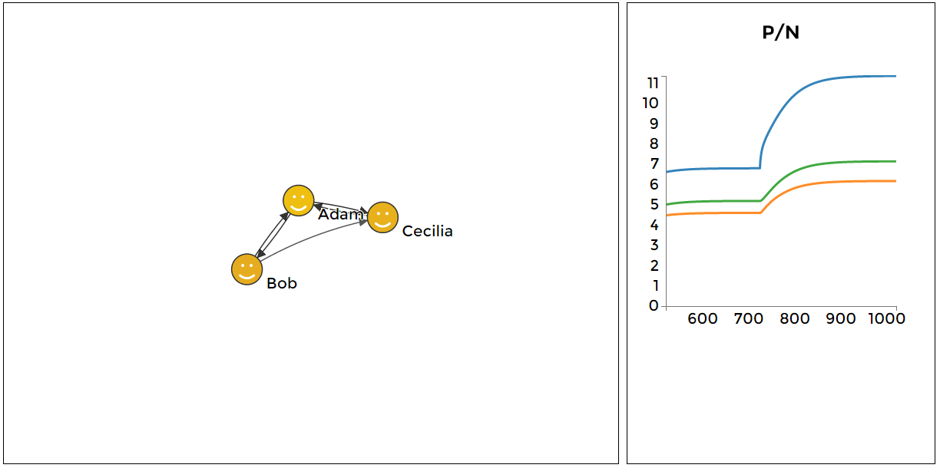
Improve agent’s personal behaviour
Re-optimizing Adam:
emotional sensitivity 0 $⇒$ 1, extroversion 1 $⇒$ 1
solution identical to initial negative steady state

Slide 21
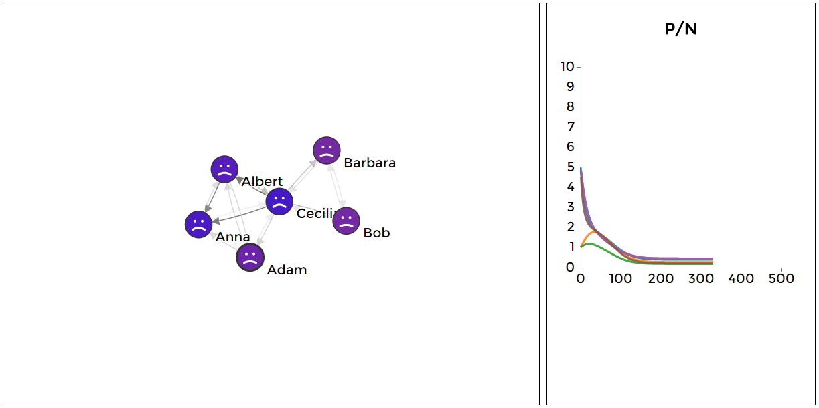
Improve team behaviour
Cecilia is the leader of two teams, A and B
different agent characteristics, Albert and Cecilia are the most positive and negative agents
strong connections within and weak between teams enforced

Slide 22
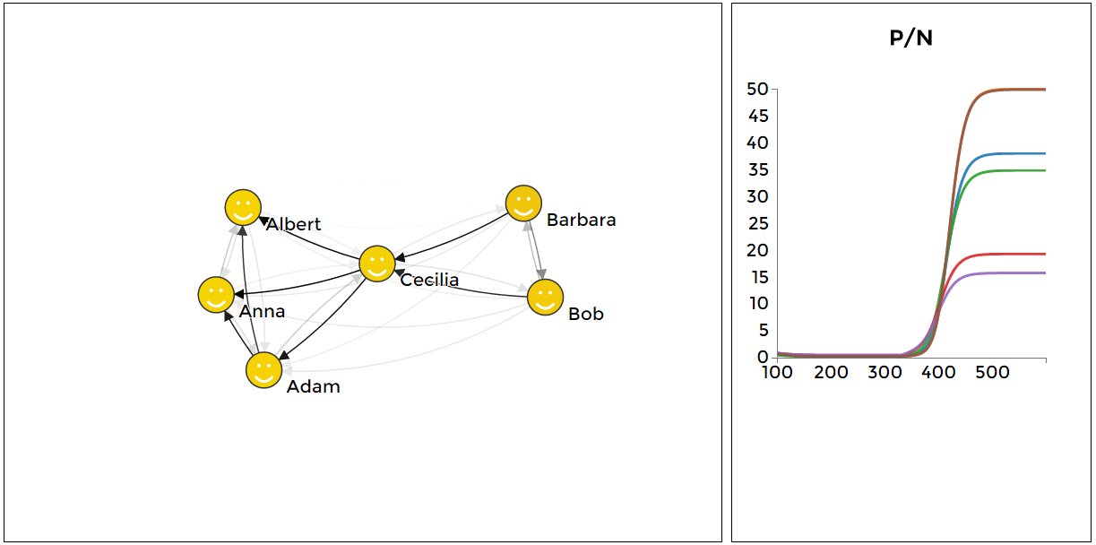
Improve team behaviour
Optimize all the agent and team parameters
minimize negativity bias, maximize general positivity, many strong connections between agents

Slide 23
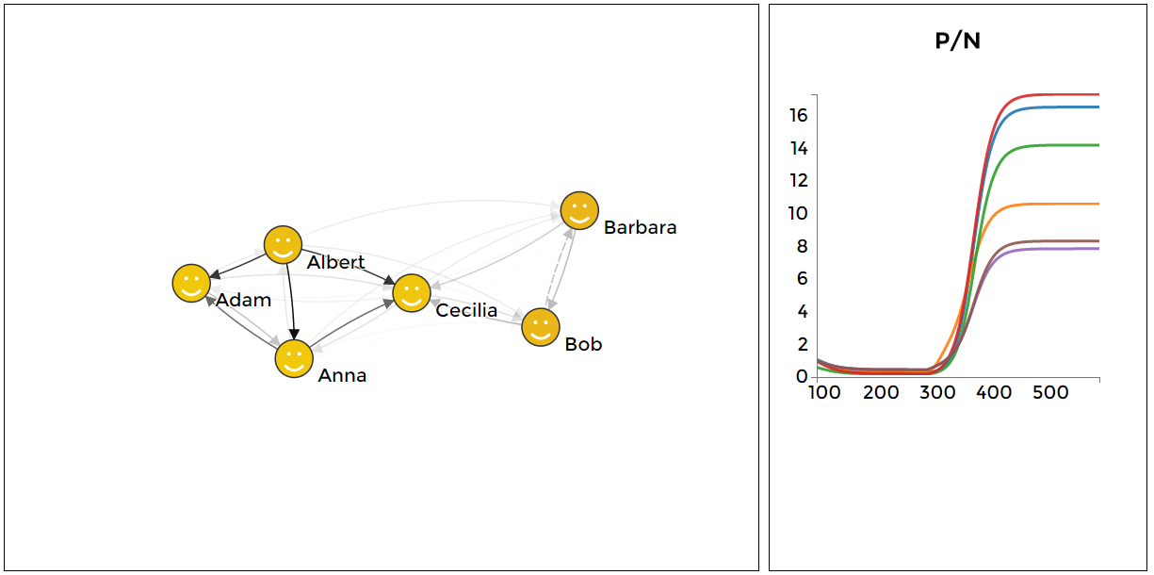
Improve team behaviour
Changing behaviour requires effort
set costs for changing behaviour and optimize
Albert has a central role in spreading positivity
Cecilia’s role is diminished

Slide 24
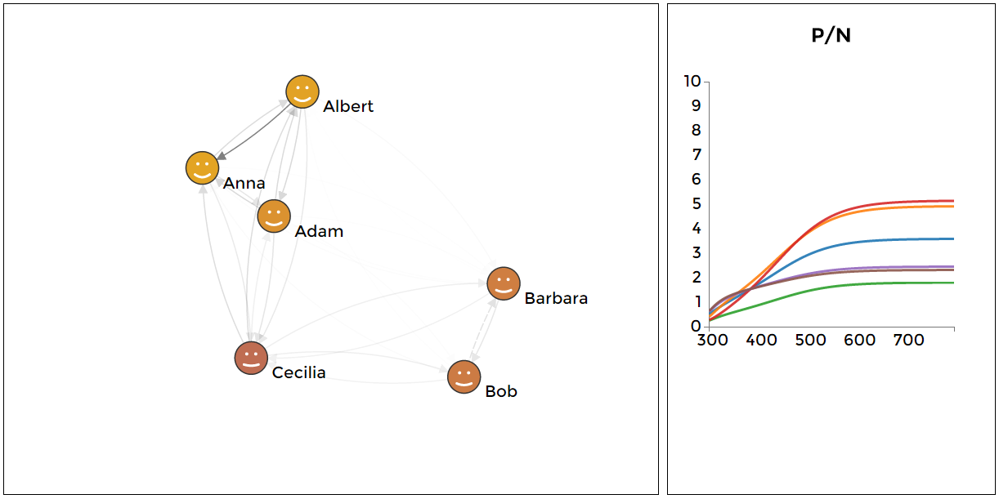
Improve team structure
Optimizing only connections between agents
Connections from Cecilia minimized, avoid spreading negativity

Slide 25
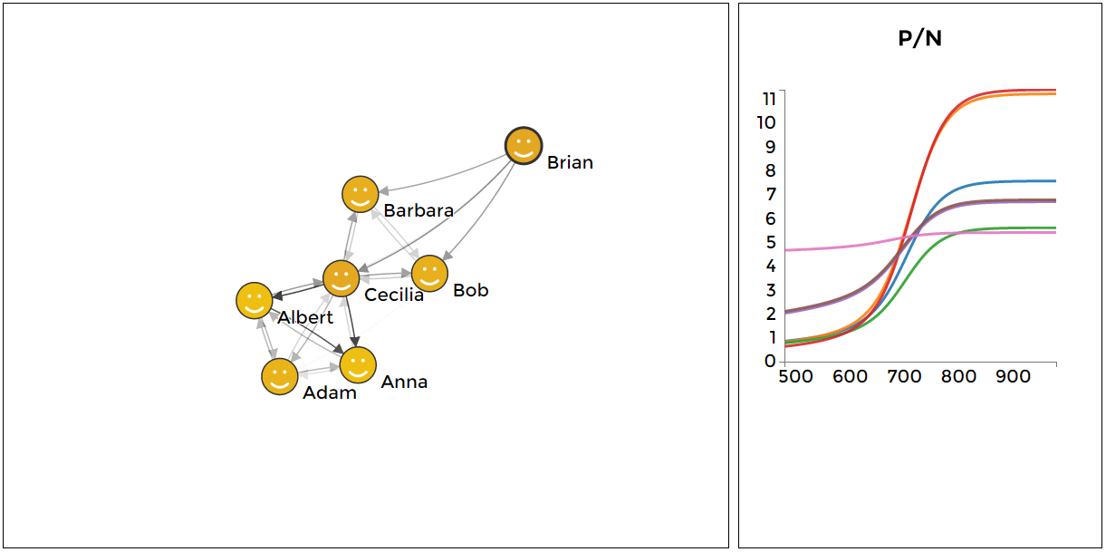
Adding a new team member
Brian is added to team B and optimized
high general positivity and extroversion, low negativity bias and emotional sensitivity
strong outgoing and weak incoming connections

Slide 26
Purpose
Engage the user in reﬂective thought-processes and facilitate seeing the system as a whole
Let the user recognize herself as an active part of the system
Demonstrate systemic effects of different behavioural and structural changes that can occur in organizations
Support systems intelligent behaviour in organizations
A tool for developing systems intelligence

Slide 27
Future work
Testing the simulator in real-world organizations
Evaluate if PoSITeams can improve SI in real life
Validation and development of the emotional contagion model
Further development of the optimization routines and the simulator software

Slide 28
References
Barsade, S. G., (2002). The ripple effect: Emotional contagion and its influence on group behavior, Administrative Science Quarterly, 47(4):644-675.
Barsade, S. G., and Gibson, D. E. (1998). Group emotion: A view from top and bottom, Research on managing groups and teams, 1:81-102.
Baumeister, R. F., Bratslavsky, E., Finkenauer, C., and Vohs, K. D. (2001). Bad is stronger than good.. Review of general psychology, 5(4):323-370.
Bosse, T., Duell, R., Memon Z. A., Treur, J., and Van Der Wal, C. N. (2009a). A multi-agent model for mutual absorption of emotions, ECMS 2009, 212-218.
Bosse, T., Duell, R., Memon Z. A., Treur, J., and Van Der Wal, C. N. (2009b). A multi-agent model for emotion contagion spirals integrated within a supporting ambient agent model, Principles of Practice in Multi-Agent Systems, 48-67.
Catalino, L. I., and Fredrickson, B. L. (2011). A Tuesday in the life of a flourisher: the role of positive emotional reactivity in optimal mental health, Emotion, 11(4):938-950.
Fredrickson, B. L. (2001). The role of positive emotions in positive psychology: The broaden-and-build theory of positive emotions, American psychologist, 56(3):218-226.
Fredrickson, B. L. (2013). Updated thinking on positivity ratios, American Psychologist, 68:814-822.
Fredrickson, B. L., and Joiner, T. (2002). Positive emotions trigger upward spirals toward emotional well-being, Psychological science, 13(2):172-175.

Slide 29
References
Fredrickson, B. L., and Losada, M. F. (2005). Positive affect and the complex dynamics of human flourishing, American Psychologist, 60(7):678-686.
Gottman, J. M. (2002). The mathematics of marriage: Dynamic nonlinear models. MIT Press, Cambridge.
Hämäläinen, R. P., Jones, R., and Saarinen, E. (2014). Being Better Better - Living with Systems Intelligence, Aalto University Publications, CROSSOVER 4/2014, Helsinki.
Hoogendoorn, M., Treur, J., Van Der Wal, C. N., and Van Wissen, A. (2011). Agent-based modelling of the emergence of collective states based on contagion of individual states in groups, Transactions on computational collective intelligence, 3:152-179.
Losada, M., and Heaphy, E. (2004). The role of positivity and connectivity in the performance of business teams a nonlinear dynamics model, American Behavioral Scientist, 47(6):740-765.
Rozin, P., and Royzman, E. B. (2001). Negativity bias, negativity dominance, and contagion, Personality and social psychology review, 5(4):296-320.
Saarinen, E., and Hämäläinen, R. P. (2007). Systems intelligence: Connecting engineering thinking with human sensitivity, Systems intelligence in leadership and everyday life, 51-78.
Senge, P. (1990). The fifth discipline: The art and practice of the learning organization, Doubleday Currency, New York.
Waugh, C. E., and Fredrickson, B. L. (2006). Nice to know you: Positive emotions, self-other overlap, and complex understanding in the formation of a new relationship., The Journal of Positive Psychology, 1(2):93-106.
Whelan, D. C., and Zelenski, J. M. (2012). Experimental evidence that positive moods cause sociability, Social Psychological and Personality Science, 3(4):430-437.

Slide 30
Thank you! Try the simulator at: http://systemsintelligence.aalto.fi/positeams
teemu.tiinanen@aalto.fi

